Slide 1
False Information Regarding Parental Alienation and What to Do About It
WILLIAM Bernet, M.d.
Family Access Symposium
Frankfort, Kentucky – October 2019

Slide 2
Robert Geffner, Ph.D.
Editor-in-Chief
Morgan Shaw, Psy.D.
Editor of Special Issue
Joyanna Silberg, Ph.D.,
and Stephanie Dallam, Ph.D.
Jean Mercer, Ph.D.
Madelyn Simring Milchman, Ph.D.
Jenna Rowen, Ph.D.,
and Robert E. Emery, Ph.D.

Slide 4
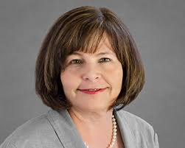
JOYANNA L. SILBERG, PH.D.
Psychology Consultant
Sheppard Pratt Hospital
Baltimore, Maryland
Executive Vice-President
Leadership Council on Child Abuse and Interpersonal Violence

Slide 5
JOYANNA SILBERG MISINFORMATION

Slide 6
SAINI ET AL. ACTUALLY SAID …
“There is remarkable agreement about the behavioral strategies parents can use to potentially manipulate their children’s feelings, attitudes, and beliefs in ways that may interfere with their relationship with the other parent. The cluster of symptoms or behaviors indicating the presence of alienation in the child can also be reliably identified.”
Michael Saini, Janet R. Johnston, Barbara Jo Fidler, and Nicholas Bala, Empirical Studies of Alienation, 2016, p. 423.

Slide 7
JOYANNA SILBERG MISINFORMATION

Slide 8
SAINI ET AL. ACTUALLY SAID …
“Alienation should be viewed as a family relational problem, not an individual pathology of one parent or child. … There are cases where one parent may have primary responsibility for ‘alienating’ a child from the other parent.”
Michael Saini, Janet R. Johnston, Barbara Jo Fidler, and Nicholas Bala, Empirical Studies of Alienation, 2016, p. 422.

Slide 10
JOYANNA SILBERG MISINFORMATION

Slide 11
IN FACT …
FIVE-FACTOR MODEL FOR DIAGNOSIS OF PARENTAL ALIENATION:
One: Child actively resists or refuses a relationship with a parent.
Two: Presence of a prior positive relationship with rejected parent.
Three: Absence of abuse, neglect, or seriously deficient parenting.
Four: Use of multiple alienating behaviors by the favored parent.
Five: Many of the eight manifestations of alienation by the child.

Slide 12
EMAIL: BERNET TO SILBERG
I have read your recent article, “Abusers Gaining Custody in Family Courts,” which is quite interesting. I would like to review the case material, the basic data, which you relied on for this research. I am particularly interested in the ten cases in which the preferred parent reportedly engaged in alienating behaviors. Can you send me the actual documents that you reviewed pertaining to those cases? At a bare minimum, can you send me the legal citations for those cases and the jurisdictions in which they occurred?

Slide 13
EMAIL: BERNET TO SILBERG
As you know, the Ethical Principles of Psychologists and Code of Conduct says, “After research results are published, psychologists do not withhold the data on which their conclusions are based from other competent professionals who seek to verify the substantive claims through reanalysis and who intend to use such data only for that purpose, provided that the confidentiality of the participants can be protected and unless legal rights concerning proprietary data preclude their release.”

Slide 15
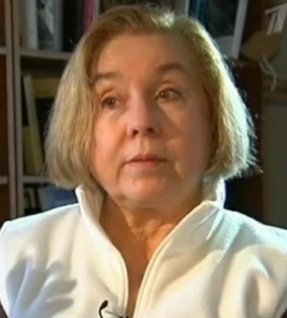
JEAN MERCER, PH.D.
Professor Emerita of Psychology
Stockton University
Founding Fellow
Institute for Science in Medicine

Slide 16
JEAN MERCER MISINFORMATION

Slide 17
WARSHAK ACTUALLY SAID …
Outcome study of Family Bridges, involving 83 children:
Richard A. Warshak, Reclaiming Parent–Child Relationships: Outcomes of Family Bridges with Alienated Children, 2018, page 15.

Slide 18
JEAN MERCER MISINFORMATION
“PA proponents have been guilty of circular reasoning since Gardner’s day … in that they have omitted the collection of data about one parent’s persuasive efforts but have never-theless assumed that [visitation resistance or refusal] is in itself evidence that the preferred parent has carried out a campaign of denigration against the non-preferred parent.”

Slide 19
IN FACT …
IN FACT, NO PROPONENT OF PA …
assumes that contact refusal “is in itself evidence that the preferred parent has carried out a campaign of denigration against the non-preferred parent.”

Slide 20
JEAN MERCER MISINFORMATION
JEAN MERCER MISINFORMATION

Slide 21

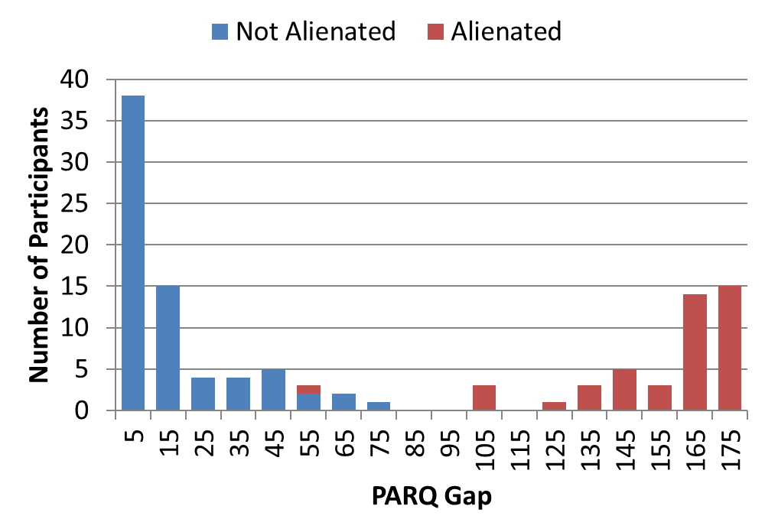



BERNET SAID …
The PARQ Gap was 99% accurate in distinguishing the mental state of severely alienated children from nonalienated children.

Slide 23
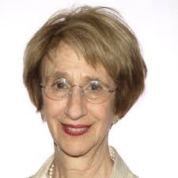
MADELYN SIMRING MILCHMAN, PH.D.
Private Practice
Montclair, New Jersey

Slide 24
MADELYN SIMBRING MILCHMAN MISINFORMATION

Slide 25
BERNET ACTUALLY SAID …
Dr. Daniel Pine said the initial proposal submitted in 2008 “did not cite enough research regarding the validity of parental alienation disorder as a concept or the reliability of the proposed criteria for the diagnosis of parental alienation disorder for this novel condi-tion to be included in DSM-5 as a mental disorder.”
HOWEVER, the DSM-5 Task Force said that parental alienation should be considered a relational problem, such as parent–child relational problem or child affected by parental relationship distress.
William Bernet, Parental Alienation, DSM-5, and ICD-11, 2013, p. 488.

Slide 27

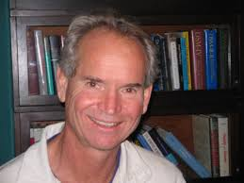
JENNA ROWEN, PH.D.
University of Illinois
at Chicago
ROBERT E. EMERY, Ph.D.
University of Virginia

Slide 28
ROWEN AND EMERY MISINFORMATION

Slide 29
IN FACT …
We found hundreds of articles in the professional literature of 38 countries …
Algeria
Argentina
Australia
Austria
Belgium
Brazil
Canada
Columbia
Chile
Cuba
Czech Republic
Denmark
Finland
France
Germany
Hong Kong
India
Israel
Italy
Japan
Latvia
Lithuania
Malaysia
Malta
Mexico
Morocco
Netherlands
Norway
Poland
Portugal
Romania
South Africa
Spain
Sweden
Switzerland
Turkey
United Kingdom
United States

Slide 31

MORGAN SHAW, PSY.D.
Editor of Special Issue
Journal of Child Custody

Slide 32
MORGAN SHAW MISINFORMATION
Richard Gardner “was implicated as being a proponent of pedophilia.”

Slide 33
RICHARD GARDNER ACTUALLY SAID …
“I consider pedophilia to be a psychiatric disorder, an abominable exploitation of children. I have never supported a pedophile in his (or her) quest for primary child custody.”
“I believe that pedophilia is a bad thing for society. I do believe, however, that pedophilia, like all other forms of atypical sexuality, is part of the human repertoire and that all humans are born with the potential to develop any of the form of atypical sexuality”

Slide 34
PUBLISHER OF JOURNAL OF CHILD CUSTODY SAYS …
“Taylor & Francis, our agents, and our licensors make no representations or warranties whatsoever as to the accuracy, completeness, or suitability for any purpose of the Content. Any opinions and views expressed in this publication are the opinions and views of the authors, and are not the views of or endorsed by Taylor & Francis. The accuracy of the Content should not be relied upon and should be independently verified with primary sources of information.”

Slide 35
WHAT CAN PRACTITIONERS, LAWYERS,
RESEARCHERS, AND TARGETED PARENTS AND GRANDPARENTS
DO ABOUT MISINFORMATION?

Slide 36
WHAT TO DO ABOUT MISINFORMATION
WRITE A LETTER TO THE EDITOR
Monitor on Psychology
Clinical Psychiatry News
Journal of Forensic Sciences

Slide 37
WHAT TO DO ABOUT MISINFORMATION
MAKE A FORMAL COMPLAINT TO THE PUBLISHER
Norstedts Juridik
American Psychological Association

Slide 38
WHAT TO DO ABOUT MISINFORMATION
PUBLISH A REBUTTAL IN THE SAME JOURNAL
Journal of American Academy of Psychiatry and the Law
American Journal of Family Therapy
Children and Youth Services Review
Family Court Review

Slide 39
WHAT TO DO ABOUT MISINFORMATION
CREATE A BLOG
For Example, “Fake News about Parental Alienation”

Slide 40
WHAT TO DO ABOUT MISINFORMATION
FILE A FORMAL ETHICS COMPLAINT
American Psychological Association
State Board of Psychology

Slide 41
WHAT TO DO ABOUT MISINFORMATION
MEET WITH YOUR CONGRESSMAN
U.S. House of Representatives and
House Concurrent Resolution 72 (2017)

Slide 42
WHAT TO DO ABOUT MISINFORMATION
WRITE A BOOK
Parental Alienation: The Handbook for Mental Health and Legal Professionals (2013)
Parental Alienation – Science and Law (2020)

Slide 43
WHAT TO DO ABOUT MISINFORMATION
MAKE A PRESENTATION
Association of Family and Conciliation Courts
Family Access – Fighting for Children’s Rights

