Slide 1
Attitudes of abused children:
Do They Exhibit Behaviors that Enhance Attachments or Distance Attachments
Amy J.L. Baker

Slide 2
Collaboration between Amy Baker, Steven G.Miller and William Bernet.
With the assistance of Trinae Adebayo
Funded by the Steel Partners Foundation
Purpose is to document the attitudes and behaviors of abused children towards their abusive caregiver.

Slide 3
Research Questions: Study Part 1
Would clinicians rate physically abused children as exhibiting behaviors that are “attachment-enhancing” or “attachment-distancing” from the abusive caregiver?

Slide 4
WhY DOES THIS MATTER?
There are certain behaviors that alienated children are known to exhibit towards a non-abusive caregiver and wanted to demonstrate that even abused children don’t exhibit these behaviors to their non-abusive caregivers.
There are several strands of research that document that abused children are in fact bonded to the abuser and we conducted this study to contribute to that evidence base.

Slide 5
Bonded to the abuser: Clinical observations
“One of the greatest conundrums for therapists treating abuse survivors is the problem of understanding the attachment of the victim to the abuser.” (Blizard & Bluhm, 1994).
Fairbairn wrote that children will assume “the burden of badness” as a defense against recognizing parental flaws. He said that children would prefer to be a “sinner in a world ruled by god than a saint in a world ruled by the devil.”
According to Judith Herman, children will go to any lengths to construct an explanation for being abused that absolves the parents of blame and responsibility.
M. Scott Peck, “To come to terms with the evil in one’s parents is perhaps the most difficult and painful psychological task a human being can be called on to face.”

Slide 6
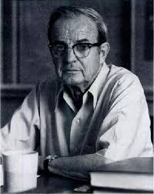
Bonded to the Abuser: Harry Harlow

Slide 7
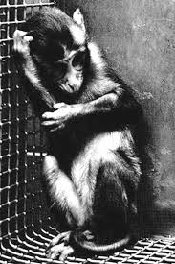

Slide 8
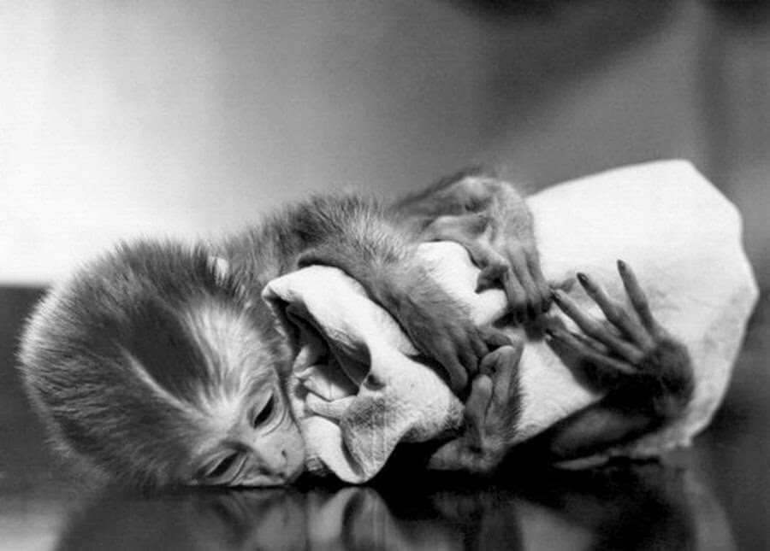
Notes:
“all the little monkeys were absolutely fanatically attached to the cloth diapers.”

Slide 9
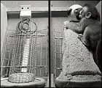
Comfort

Slide 10
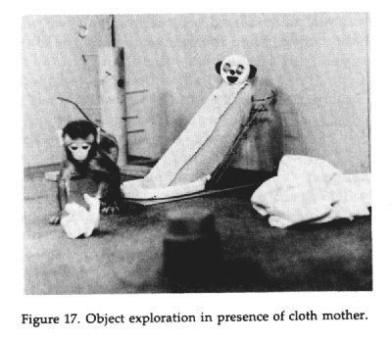
Exploring the Environment

Slide 11
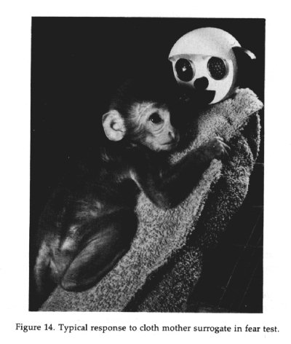
Fear Induced Security-Seeking

Slide 12
Harlow and his team noted, “the desperate efforts the babies made to contact their mothers. No matter how abusive the mothers were, the babies persisted in returning.”

Slide 13
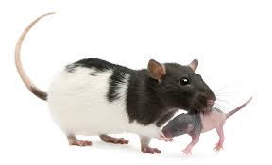
Pain Studies
Animal Studies

Slide 14
Pain Studies
Moriceau and Sullivan (2006):
Two groups of rats:
Group 1: Paired a smell and an aversive shock near the mother.
Group 2: Paired a smell and an aversive shock not near the mother.
Question: Will the rats associate the smell with pain and show a pain response?
Results: The smell did not evoke fear response for group 1 although it did for group 2.
Conclusion: “A mother’s presence is a biochemical off switch for fear.”
“The mother’s ability to modify fear learning circuitry may provide clues to abusive attachment”

Slide 15
Pain Studies
Drouineau et al 2017:
2 groups of children:
Group 1: 39 children with accidental burn or fracture
Group 2: 39 abused children with burn or fracture
Question: Do abused children experience/express pain differently than non abused children?
Results: Doctors scored abused children as experiencing less pain than non-abused children with comparable injuries.
“The behavior of abused children is less demonstrative of pain than children suffering from accidental injuries.”

Slide 16
Attachment Studies

Slide 17
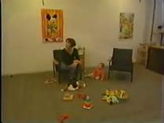
The Strange Situation

Slide 18
Secure Vs. Insecure Attachment
Based on the infant’s reaction to being with the mother alone, with the mother and the stranger, and with the stranger alone, all alone, and then with the mother again, the infants were classified into three attachment categories:
The secure infants were those who explored the environment when with the mothers, missed her while she was gone, and gained comfort from her when reunited.

Slide 19
Attachment Studies
Meta analysis of 10 studies (400+ children) found high likelihood of maltreated children not being securely attached.

Slide 20
Foster Youth Studies

Slide 21
Foster Youth Studies
Baker et al (2017) analyzed 27 studies in which foster youth were interviewed about their experience of being in foster care.
Three coders blind to the hypotheses
3 attachment-related constructs: (1) yearning for the parent, (2) fear of separation and (3) self-blame and/or minimized the abuse.

Slide 22
Foster Youth Studies
THEME Relevant Study Issue found in study
Attachment 25 25 (100%)
Fear 18 15 (83.3%)
Self-blame 16 15 (93.8%)

Slide 23
Foster Youth Studies: Yearning
“Many young people took every opportunity to reiterate that they missed their families, would like more contact with family and friends and would like to return home eventually.”
“No matter what their parents had done, all the respondents missed and longed for their birth parents, and thought about them frequently.”
“The desire to return home and to be loved by parents dominated the wish lists.”

Slide 24
Memoirs

Slide 25
Memoirs
45 memoirs of adult survivors of childhood parental maltreatment were read.
The overwhelming issue across all of the books – regardless of the gender of the author or gender of the parent or age the abuse occurred or type of abuse was an attachment to the abuser and a desire for a repaired relationship.

Slide 26
Why do children form attachments with abusive caregivers?
In sum....
Because they cannot help it. (i.e., hard-wired).
What is affected is the quality of the attachment not whether there is an attachment.

Slide 27
Why Do Children Love Their Abusive Parents?
The parents are not always abusive. Presumably there are some positive moments. The positive reinforces the attachment.
The child doesn’t have any context to know that what is happening in the home is not normal.
Because there is a pre-existing attachment, which is very hard to extinguish.
The children take the blame for the abuse to preserve the “good” parent. The desire to believe the promise of the good parent is very powerful.

Slide 29
The current study

Slide 30
Study Methods: The Sample
Two samples of clinicians were used:
Clinicians providing therapy to children removed from home due to abuse and neglect.
Clinicians listed as being trained in TF-CBT and who confirmed in screening survey that they have experience working with physically abused children.
80% response rate, resulting in 338 clinicians.

Slide 31
Study Methods: The Survey
In addition to questions about the participants, we asked each participant to answer 18 items about the attitudes and behaviors of their child clients towards their caregiver.
Nine items were “attachment-enhancing” such as “worried about the feelings of the parent”, “blames self for the abuse”, and “recalled positive memories of the caregiver.”
Nine items were “attachment-distancing” such as “Refused contact with the caregiver,” “held persistently negative view of the caregiver,” and “idolized the other parent.”

Slide 32
Attachment-enhancing items
Worried about feelings of maltreating parent
Invested in better relationship with maltreating parent
Recalled positive memories of maltreating parent
Maintain relationships with kin of maltreating parent
Had realistic complaints about maltreating parent
Saw good and bad in maltreating parent
Sided with maltreating parent in all conflicts with others
Minimized impact of abuse by maltreating parent
Blamed self for abuse by maltreating parent

Slide 33
Attachment-disrupting items
Refused to have contact with the abusive parent
Idolize the other parent
Persistently negative view of maltreating parent
Rude and arrogant toward maltreating parent
Weak, frivolous reasons for upset with maltreating parent
Repeated negative comments about maltreating parents
Did not care about feelings of maltreating parent
Denied influence of others
Unnecessarily angry at family of maltreating parent

Slide 34
Study Methods: The Survey
Four versions of the survey: The clinician is asked to rate….
A specific severely physically abused child.
A specific moderately physically abused child.
3. Severely physically abused children in general.
4. Moderately physically abused children in general.

Slide 35
Study 1: Findings
Two scales were created:
Sum of 9 attachment-enhancing items (AE), alpha =.78
Sum of 9 attachment-disrupting items (AD) alpha = 68.

Slide 36
Study 1: Findings
Four paired t-tests to see whether within each sample the rates of AE would be statistically higher than rates of AD:
Mean AE Mean AD t
Severely Abused Specific 19.6 (5.2) 11.5 (4.2) 9.5 ***
Moderately abused Specific 18.5 (5.6) 12.7 (4.5) 7.3 ***
Severely Abused in General 21.7 (3.4) 13.9 (3.6) 14.0***
Moderately Abused in General 21.3 (3.3) 14.7 (3.3) 12.3***

Slide 37
Study 1: Findings
A difference score was created by subtracting the AD from the AE scores.
Positive score means more AE than AD 83.6%
Negative score means more AD than AE 12.7%
Score of 0 – no difference between AD and AE 03.6%

Slide 38
Study 1: Findings
No statistical difference between the ratings of the severely and moderately abused children.
There were differences in the ratings of general versus the specific children, with ratings of children “in general” higher than ratings of a specific child for both AD and AE behaviors. Children in general seen as more extreme than a specific child.

Slide 39
Study 1: Implications
Clinicians can share these findings with abused children to help normalize the experience of wanting to stay connected to a parent who has hurt them.
Understanding that we as humans are hard-wired to form and maintain attachments – even to abusive parents – can help child clients process their own emotions and experiences.
Clinicians can anticipate that child clients who have been abused are likely to minimize the pain caused to them and to blame themselves for the abuse.

Slide 40
Study 1: Implications
Clinicians can help children develop balanced and reality-based experiences of both parents.
Clinicians can help abusive parents not take advantage of the child’s minimization as part of their work in accepting what they have done and developing less destructive parenting strategies.

